Slide 1
Why does a rule based approach to understanding HTML not work?

Slide 2
Why does a rule-based approach not work?
Rules have too many edge cases due to the freedom of the web.
Doesn’t scale and very expensive to maintain at web scale.
Example of a rule-based approach: PFWebViewController
Covers < 30% of DO/DT
For 70% of cases, quality is on par with our approach; for 30% it is worse.
Code snippet showing complexity:

Slide 3
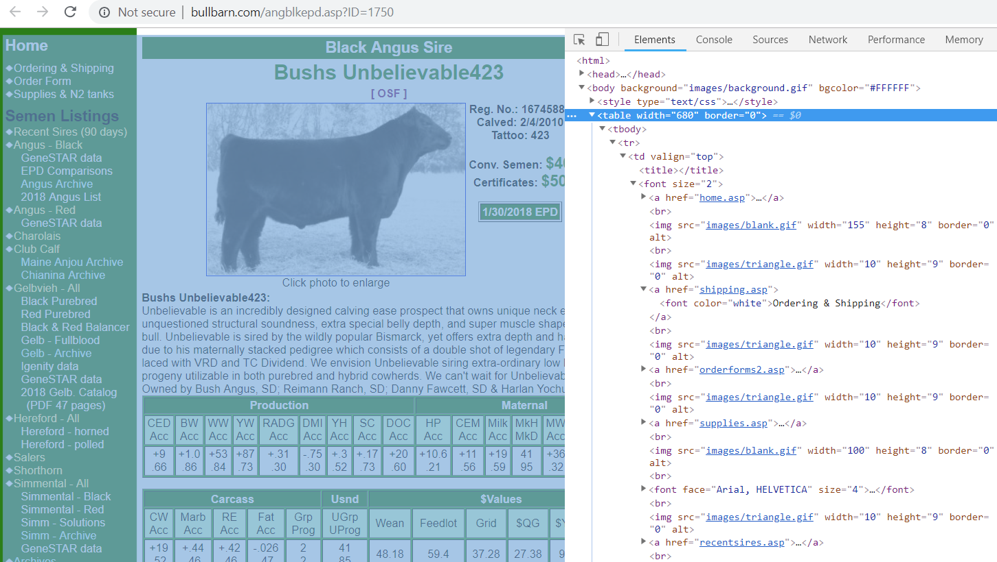
Why does a rule-based approach not work?
<table> being used for the page layout

Slide 4
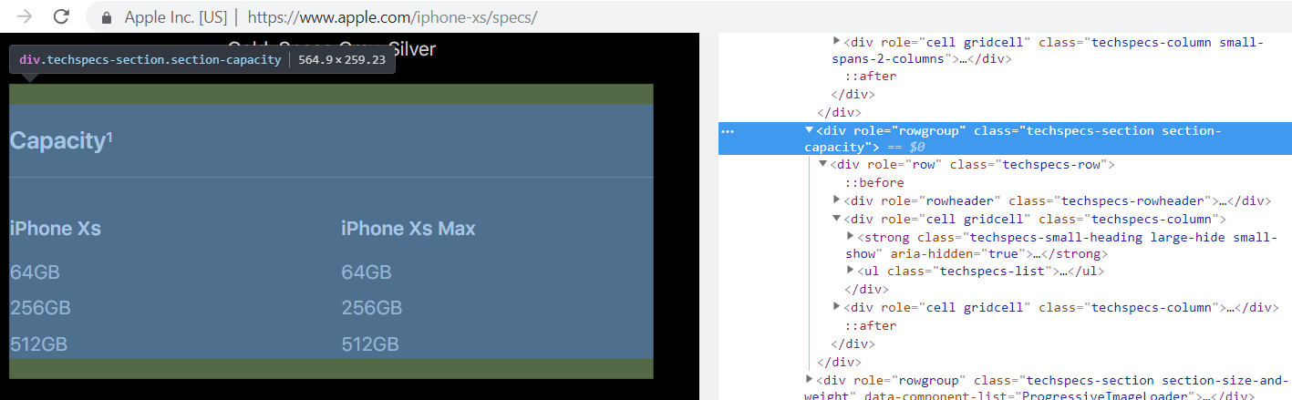
Why does a rule-based approach not work?
<div> is used to display a table

Slide 5
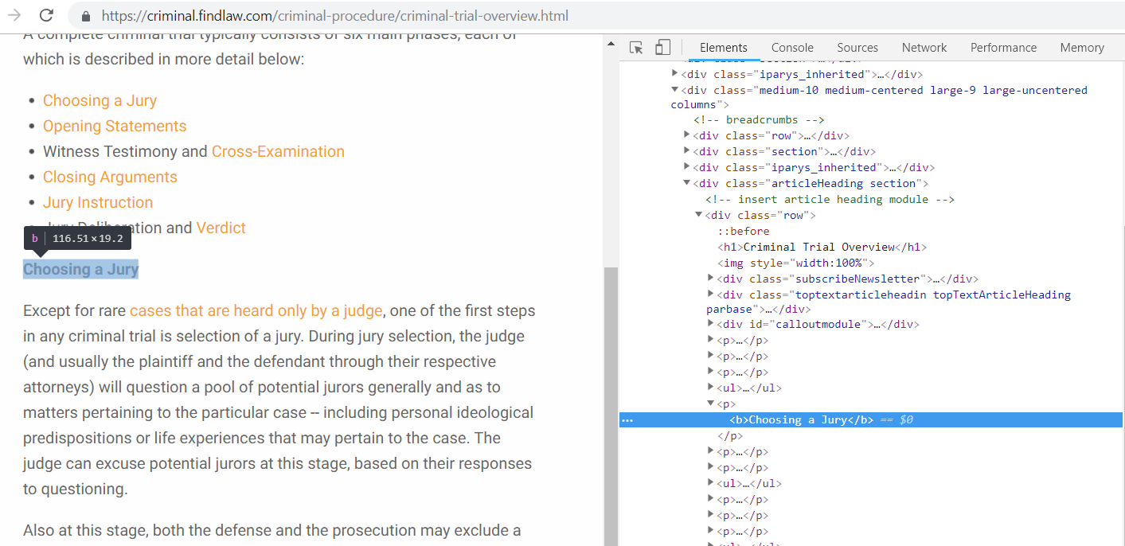
Why does a rule-based approach not work?
<b> and <p> used as a heading

Slide 6
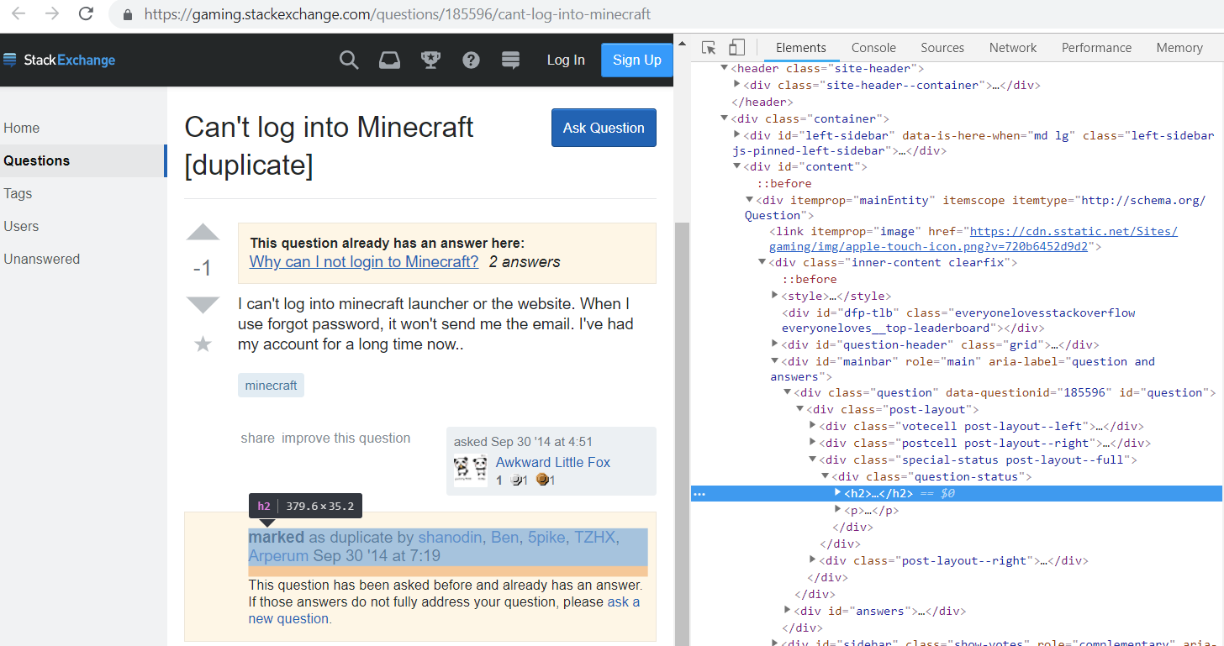
Why does a rule-based approach not work?
<h2> used for non-heading purposes

Slide 7
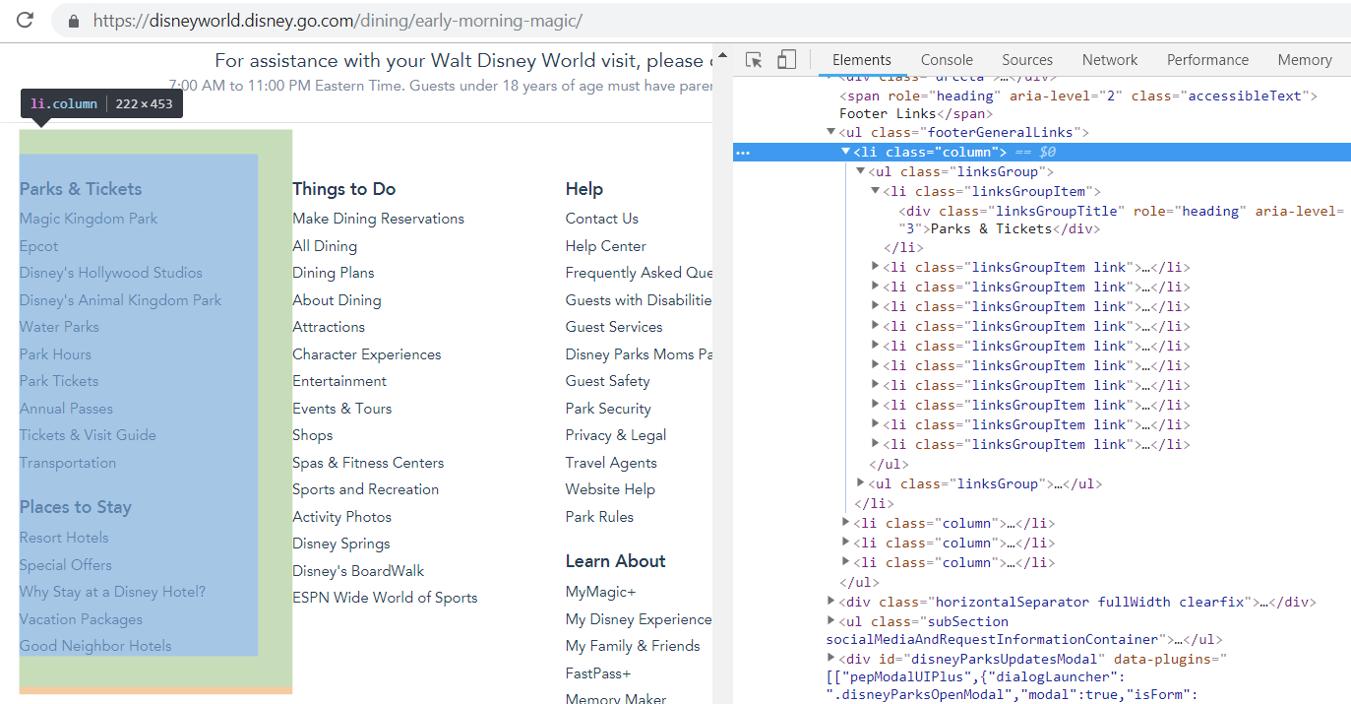
Why does a rule-based approach not work?
<ul> and <li> elements used for page layout purposes

Slide 8
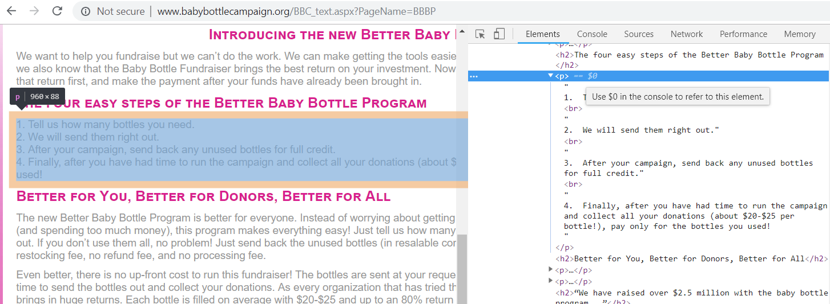
Why does a rule-based approach not work?
<p> and <br> used as a list

